Slide 1

Advisory Council Meeting
May 7, 2025
HAMPTON BUDGETING 2025-2026

Slide 2



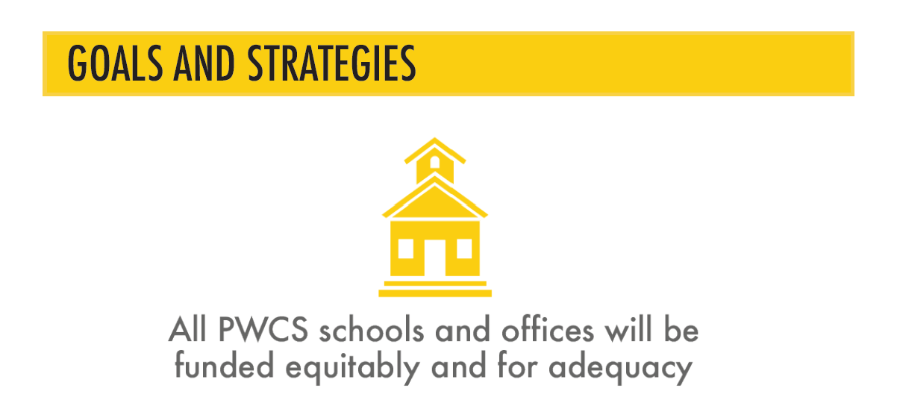

Slide 3
Prince William County Public Schools Budget (FY 2026)
Prince William County Public Schools (PWCS) approved a $1.89 billion budget.
Focuses on student achievement, workforce support, and operational efficiency.
Ensures effective resource allocation for education quality.
Where does
the
money go?
PORTFOLIO DIVISIONAL OFFICER

Slide 4
Prince William County Public Schools Budget (FY 2026)
Budget Breakdown:
Instruction – $1.16 billion (teacher salaries, classroom resources).
Technology – $91.8 million (devices, cybersecurity, online learning).
Facilities & Maintenance – $79.6 million (school upkeep, renovations).
Pupil Transportation – $80 million (buses, logistics, safety).
Food Services – $255.8 million (nutritious meals, reduced lunch programs).
Student & Health Services – $133 million (mental health, counseling, attendance programs).

Slide 5
FUNDING SOURCES
Where does the money come from?
State & local taxes – Largest contributors.
Federal grants – Targeted funding for specialized programs.
Bonds & loans – Financial tools for school expansion and construction.
Miscellaneous revenue – Fees, sponsorships, and partnerships.
PORTFOLIO DIVISIONAL OFFICER

Slide 6
Impact on Student Achievement
  Higher teacher salaries → Better retention and educational quality.
  Improved technology → More learning opportunities & digital access.
  Better facilities → Enhanced learning environment & student comfort.
  Transportation improvements → Reduced tardiness & absenteeism.
  Health & nutrition programs → Increased focus & academic performance.
Equitable Budgeting

Slide 7
PWCS BUDGET HISTORY OVERVIEW
  Budget constraints – Potential limitations on program expansions.
  Inflation & costs – Inflation & rising costs could impact classroom resources.
  Maintaining competitive salaries is crucial to retaining educators. Rising expenses affect salaries & resources.
  Future priorities – Long-term investment in technology will be essential for future learning.
Challenges
&
Considerations

Slide 8
PWCS EQUITY DEFINITIONS
Prince William County Schools are investing in student-centered funding.
The FY 2026 budget prioritizes instructional excellence, technology, and health.
Future considerations will focus on equitable funding, sustainability, and adaptability.
A Path Forward

Slide 9
What is Adequacy?
Educational adequacy is a legal theory that calls for the provision of a high-minimum quality education for students
Adequacy is essential to a high-quality education
Federal then state level emphasis
Value-driven concept
  Standard of excellence
  Unique learning needs
  Academic elective, extra- and co-curricular offerings
Costing Out Method
  Economic Cost Function
  Successful School District
  Professional Consensus
  Cost of state of the art, or best practices
“…providing sufficient funds for the average school to teach the average child to the state standards, plus sufficient additional revenues for students with special needs [learning disabilities, poverty, educationally deficient backgrounds and English proficiency] to be taught to high rigorous standards.
Odden & Picus 2004, p.25

Slide 10
School Membership FY26
6th Grade – 305 Students
7th Grade – 319 Students
8th Grade – 287 Students
Total Students = 911
Community Eligibility = 428
Gifted = 135
Special Education = 108

Slide 11

Calculation Sheet
July 1, 2025
05-Feb-25
School: Hampton Middle School 464
Self-Contained Programs Students Per Pupil Allocation
Level 1
Kindergarten 0 X $8,217 = $0
Level 2
Regular Elementary School (Grades 1-3) 0 X $6,490 = $0
Regular Elementary School (Grades 4-5) 0 X $6,287 = $0
Level 3
Regular Middle School (Grades 6-8) 887 X $6,615 = $5,867,505
Middle School Class Size Reduction 887 X $164 = $145,468
Level 4
Regular High School (Grades 9-12) 0 X $6,721 = $0
High School Class Size Reduction 0 X $164 = $0
Level 5
Early Childhood SPED Community Based 0 X $10,284 = $0
Level 6
Early Childhood SPED 2-Year Old 0 X $14,475 = $0
Level 7
Intellectual Disabilities- Mild 10 X $17,875 = $178,750
Hearing Impaired 0 X $17,875 = $0
Orthopedically Impaired 0 X $17,875 = $0
Emotional Disabilities 0 X $17,875 = $0
N/A 0 X $164 = $0
Intellectual Disabilties-Moderate 0 X $164 = $0
Level 8
Early Childhood SPED 3-5 Center Based 0 X $18,053 = $0
Level 9
N/A 0 X $21,917 = $0
Autism (Grades K-12) 16 X $21,917 = $350,672
Intellectual Disabilities- Severe 0 X $21,917 = $0
Level 10
PACE Regional Program 0 X $27,641 = $0
Resource Programs
Adapted Physical Education 0 X $1,718 = $0
Autism Spectrum Disorder (funded in Special Ed Le 0 X $0 = $0
Economically Disadvantaged (Grades K-5) 0 X $1,321 = $0
Economically Disadvantaged (Grades 6-8) 428 X $592 = $253,376
Economically Disadvantaged (Grades 9-12) 0 X $592 = $0
Elementary Strings 0 X $779 = $0
English for Speakers of Other Lang. (Lvl 1-5) 0 X $0 = $0
English for Speakers of Other Lang. (Lvl 6/M/OO) 0 X $0 = $0
Gifted Education (Grades K-3) 0 X $3,663 = $0
Gifted Education (Grades 4-5) 0 X $1,664 = $0
Gifted Education (Grades 6-8) 135 X $1,104 = $149,040
Gifted Education (Grades 9-12) 0 X $769 = $0
Hearing Impaired 0 X $10,294 = $0
Occupational Therapy 0 X $5,296 = $0
Physical Therapy 0 X $3,573 = $0
Emotional Disabilities (funded in Special Ed Level 0 X $0 = $0
Special Education Level 1 MS 105 X $8,097 = $850,185
Speech & Language Impaired 0 X $1,863 = $0
Visually Handicapped 0 X $3,796 = $0
Per Pupil Allocations $7,794,996
Baseline Allocation $4,374,386
Replacement Equipment Allocation $58,154
Elementary Class Size Supplement $0
Reduced K-3 Class Size Incentive Grant $0
Carry-Over from Previous Year $0
Total Special Ed Allocation (1,629,719)

Slide 12
Hampton Middle School
Self-Contained Programs Students Per Pupil Allocation
Regular Middle School (Grades 6-8) 887 X $6,615 = $5,867,505
Middle School Class Size Reduction 887 X $164 = $145,468
Intellectual Disabilities- Mild 10 X $17,875 = $178,750
Hearing Impaired 0 X $17,875 = $0
Orthopedically Impaired 0 X $17,875 = $0
Emotional Disabilities 0 X $17,875 = $0
Autism (Grades K-12) 16 X $21,917 = $350,672
Intellectual Disabilities- Severe 0 X $21,917 = $0
Economically Disadvantaged (Grades 6-8) 428 X $592 = $253,376
Gifted Education (Grades 6-8) 135 X $1,104 = $149,040
Emotional Disabilities (funded in Special Ed Level 0 X $0 = $0
Special Education Level 1 MS 105 X $8,097 = $850,185
Speech & Language Impaired 0 X $1,863 = $
Visually Handicapped 0 X $3,796 = $0
Per Pupil Allocations $7,794,996
Baseline Allocation $4,374,386
Replacement Equipment Allocation $58,154
Total Special Ed Allocation (1,629,719)
Adjustment (Add Back) for Non-Sped related per pupil 12,965
Total Non-Sped Allocation (Budgeted in the Non-Sped appropriation unit) 10,610,782
Level II Special Ed (Budgeted in the Sped appropriation unit) 645,007
Level I Special Ed (Budgeted in the Sped appropriation unit) 850,185
Special Ed Chair 121,562
Total Allocation $12,227,536

Slide 13
Data Continued on Screen

